Slide 1


Measuring Complexity a practical guide for Python and modern architectures
with Maxim Danilov

Slide 2
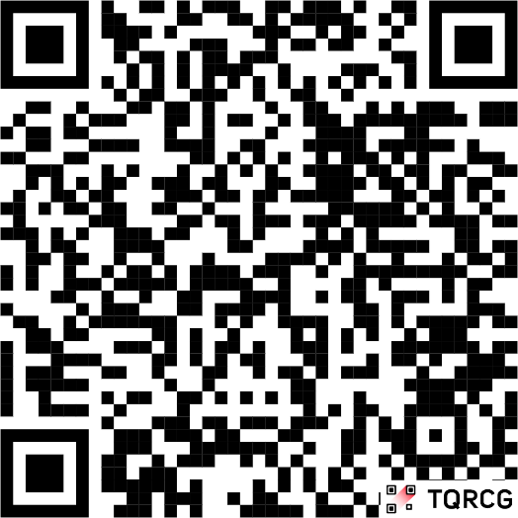

Who I am
Maxim
29 years in commercial software development
11 years with Python
9 years with reactive frontend frameworks.
I am a mentor for developers ADPlist.org

Slide 3
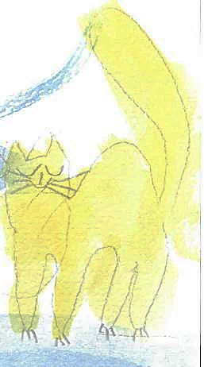



Special thanks to my family for the support:
cat
Kisa
daughter Maja
son
Mark
dog
Marselle
My wife
Elena

Slide 4

Thanks to my children Mark & Maja for the illustrations

Slide 5

Disclaimer

Slide 6

All talks about software complexity are:
completely subjective
And we don’t have any clear objective metric

Slide 7

Complexity
What, where, why

Slide 8

Types of complexity
Cognitive
Accidental
Structural
Essential

Slide 9

Technical (essential) Complexity
Present chosen technology / algorithm. (part of the code as a irreducible block)
Exists as is, cannot suddenly appear or dissapears.
Reflected through Big O notation (Mathematical Complexity).
Measurements: CyC (Mackabe index), big_O metric.

Slide 10
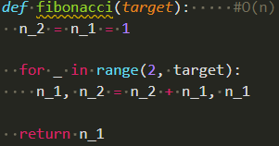
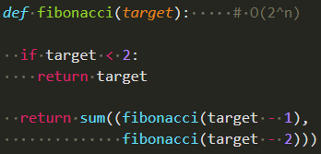

Example:
O(n)
O(2^{n})

Slide 11

Structural Complexity
Relations between parts of the project. Reflect applied programming patterns, project organizing.
Affected on strict Project design.
Appears by premature optimisation, breaking YAGNI, or overengineering by following SOLID
Measurements: Mi, C/m or functions counts, Dependencies index…

Slide 12
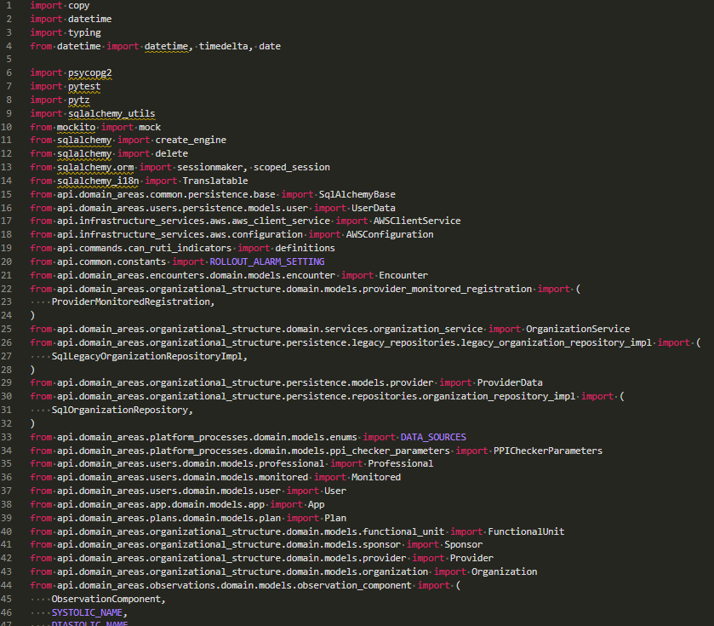
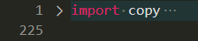

Example
168 imported objects in 131 import lines
Django/db/models/functions/__init__.py :
91 imported object in 6 lines
FastAPI/dependencies/utils.py:
68 object imported in 20 lines.

Slide 13

Cognitive complexity
Readability
Understandability, ability to mentally reproduce logic
Affected by code style guides, correct comments, documentation
Strictly Human oriented metric
Measurements: halstead metric, Sonar CgC, DocCoverage

Slide 14

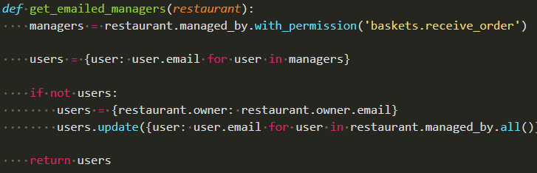
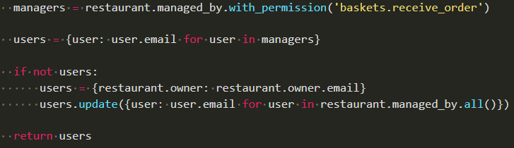
Example:

Slide 15

Example:

Slide 16

Example:

Slide 17

Accidental Complexity
Compromises due to unaligned code parts. MVP converted to permanent solution.
Affected by strict schemas and specifications.
Appears more often in startup/AI-assisted projects.
Increases implicitly.
Measurements: unusual activity and Code churns in local places.

Slide 18
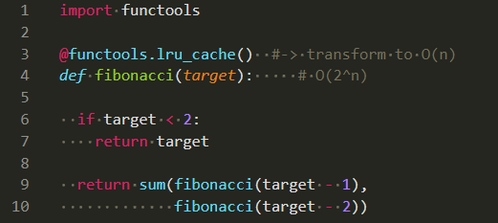


Example:

Slide 19

metric of Complexity
From obivious to rare

Slide 20
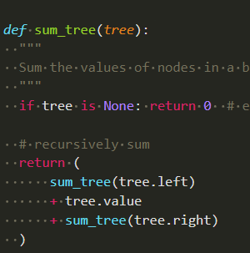
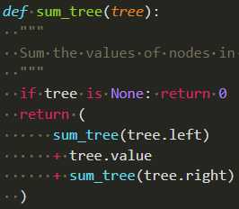
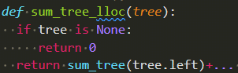

LOC, SLOC, LLOC – general metrics
LOC
Code itself
Reality 🥺
SLOC
Cleaned source code
Used in metric 🤓
LOC
Source code
To share it for all 😎

Slide 21
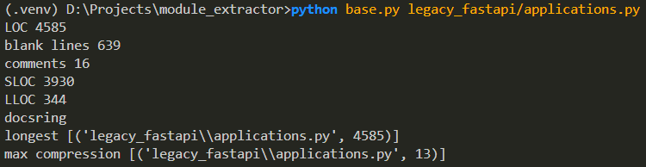
LOC, SLOC, LLOC – example:
https://github.com/danilovmy/dependency-extractor

Slide 22
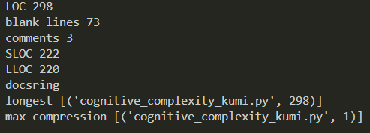
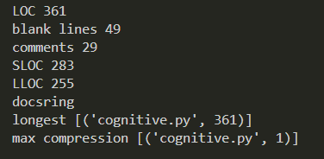


LOC, SLOC, LLOC – 🤖 vs 🧑:
🤖
🧑

Slide 23

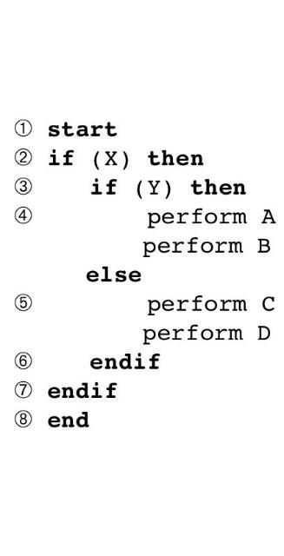
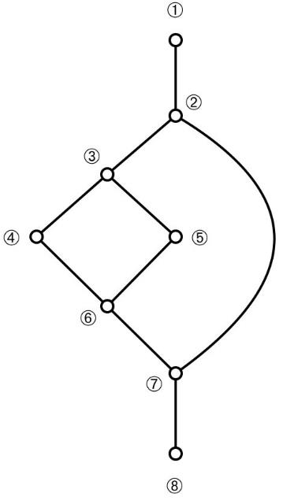
McCabe index (TC)
Reflects quantityof decision points.
Gives a penalty for every logical structure.
Forces to use less effective constructions to achieve better results.
Can be used in prompts:
„write a code with CyC less than 10“

Slide 24
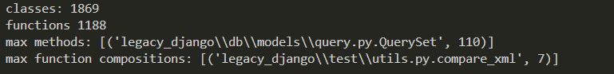

Class / Func index (TC, SC)
> python stats.py legacy_django -r
Anemic models, God Classes and Heavy function compositions.
Programming paradigm (61% Cb vs 39%Fb)
- Broken by functions composition
- Pytest/Unittests should not be counted.

Slide 25
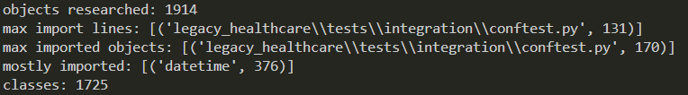

Dependency Index (SC)
Coupling/Cohesion index.
> python stats.py legacy_healthcare -r
- dynamic imports are not included.

Slide 26
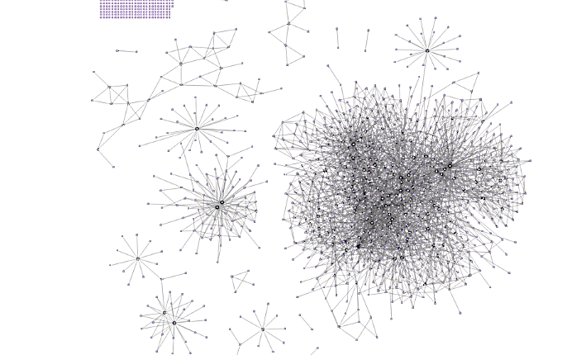


Dependency Index (SC)
NanoAPI visual maps

Slide 27

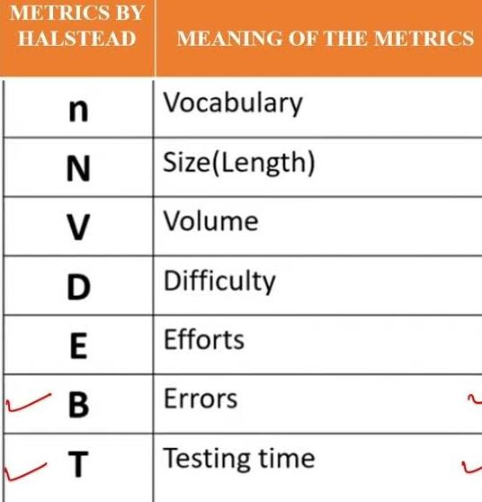
Halstead metric, (CC)
Reflects readabilityof code as a text
Give small penalty for every name
Give hard penalty for every statement
Give hard penalty for every operator
Forces to apply DRY on maximum.

Slide 28
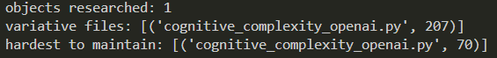
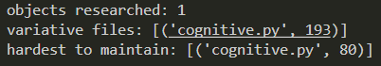


Halstead metric 🤖 vs 🧑:
🤖
🧑
AI generated code have bigger vocabulary, yet.

Slide 29
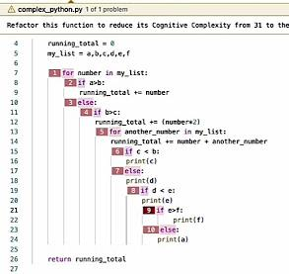

Cognitive Complexity Index (CC)
Presented in 2017 by Sonar (SonarCloud).
Mutated from CyC,
Give penalty for code constructions
gives a hard penalty for nested blocks
Forces to write plain code.
- not adopted for Python, calculated wrong even in Sonar.

Slide 30

Maintainability Index (AC)
Created by Software Engineering Institute in 1997
171 - 5.2*ln(Hal) - 0.2*Cycl - 16*ln(SLOC) + 50*sin(sqrt(2*Comments))
Index value | Color | Meaning
0-9 | Red | Low maintainability of code
10-19 | Yellow | Moderate maintainability of code
20-100 | Green | Good maintainability of code

Slide 31
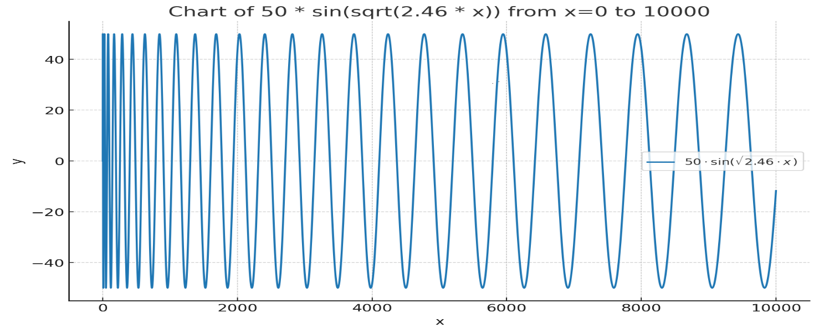

Maintainability Index depends on comments
Implemented by Radon, SonarQube, Microsoft Visual Studio, Wily, ProjectCodeMeter…

Slide 32
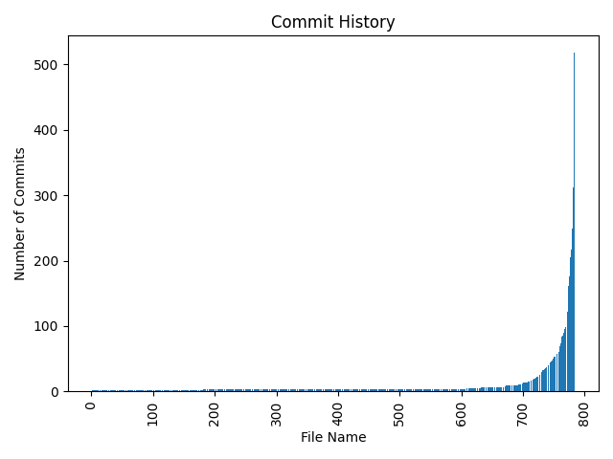

Accidental Complexity (AC)
„Changed code concentrate AC“
Code churns metric,
project «heat» maps.
Shows what should be 100% tested

Slide 33

Working with Complexity
Fight with invisible enemy

Slide 34

Why teams fail at managing complexity:
Requirements for Complexity handling
should be reflected on business level.

Slide 35

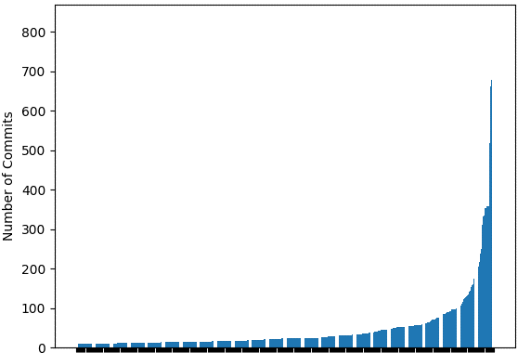
Defining refactoring Hot Zones
Only few files change often (Feathers)
Some files must be clean,
Ignore the rest (Fowler)
20% changes affect 80% results
(pareto)
Refactoring steps
should be done there

Slide 36

Watching Complexity
Points of concentrated complexity can be located easy.
Only Watching complexity metric through the time help to detect complexity grow.
Define threshold complexity metric for Hot Zones on the current state and watch, what happens.

Slide 37

Complexity
Recup and homework

Slide 38

Last words about measuring tools
Radon. Not works with type annotated dataclass’es
Sonar cloud. Due language agnostic works not well with python code.
AIkido, code quality measurements not works.
All services builded on radon (xenon, willy, CodeClimate, Codacy…) works not correctly.
That’s why I have created my own tools

Slide 39

Complexity recup
It is normal
Can be find only in comparance before – after
Should be handled on the same level as documentstion or code testing.
Is completely subjective!

Slide 40

Try it at home.
Chooze a project.
Find a Zero tech debt zone.
Find in this zone Compexity points (AC, CgC, SC)
Find a file with statistically biggest complexity / higer compression.
Try to improve it.
Enjoy… After repeate.

Slide 41


Time to refactor questions to ansvers.
Maxim Danilov
maxim@wpshop.at
Repo: github.com/danilovmy/dependency-extractor

Slide 42

Related links
https://github.com/rubik/xenon/blob/master/xenon/core.py
https://radon.readthedocs.io/en/latest/commandline.html#radon-configuration-files
https://stackoverflow.com/questions/52741725/what-is-cognitive-complexity-in-sonar-report
https://dev.to/optiklab/writing-self-documented-code-with-low-cognitive-complexity-3k2l
https://blog.devgenius.io/sonarqube-cognitive-complexity-265640dbad3e
https://medium.com/@himanshuganglani/clean-code-cognitive-complexity-by-sonarqube-659d49a6837d
https://rohaquinlop.github.io/complexipy/
https://github.com/Melevir/cognitive_complexity/blob/master/tests/test_cognitive_complexity.py
https://github.com/rohaquinlop/complexipy/blob/main/src/cognitive_complexity/mod.rs
https://github.com/ganncamp/cognitive-complexity/blob/master/src/main/java/com/sonarsource/rules/java/checks/CognitiveComplexityCheck.java
https://community.sonarsource.com/t/cognitive-complexity-calculation-for-a-file-project/108367
https://www.sonarsource.com/blog/5-clean-code-tips-for-reducing-cognitive-complexity/
https://www.youtube.com/watch?v=x5V2nvxco90
https://www.youtube.com/watch?v=el9OKGrqU6o
https://www.sonarsource.com/docs/CognitiveComplexity.pdf
https://wemake-python-styleguide.readthedocs.io/en/1.0.0/pages/usage/violations/complexity.html
https://swimm.io/learn/developer-experience/how-to-measure-code-churn-why-it-matters-and-4-ways-to-reduce-it
https://github.com/astral-sh/ruff/discussions/20699
https://medium.com/@stevekowalski_47184/software-complexity-is-it-worth-measuring-98fba5244261
https://speakerdeck.com/matthiasmullie/software-metrics?slide=17

